Slide 1
LF111/101 Lecture topic (6) 19 January 2023
Recombinant DNA technology
Genetic Engineering

Slide 2
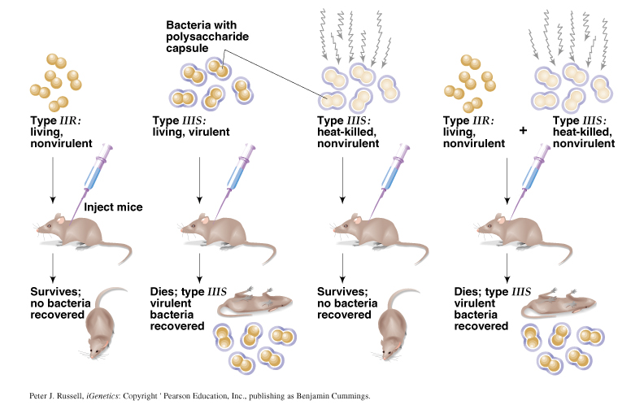
Recap:
Bacterial transformation
Griffith’s experiment
What does transformation signify?
An incoming bacterial factor (DNA ) could replace an endogenous factor
What opportunities does this observation offer?
Could an incoming DNA ( foreign gene) be made to stay in a cell?

Slide 3
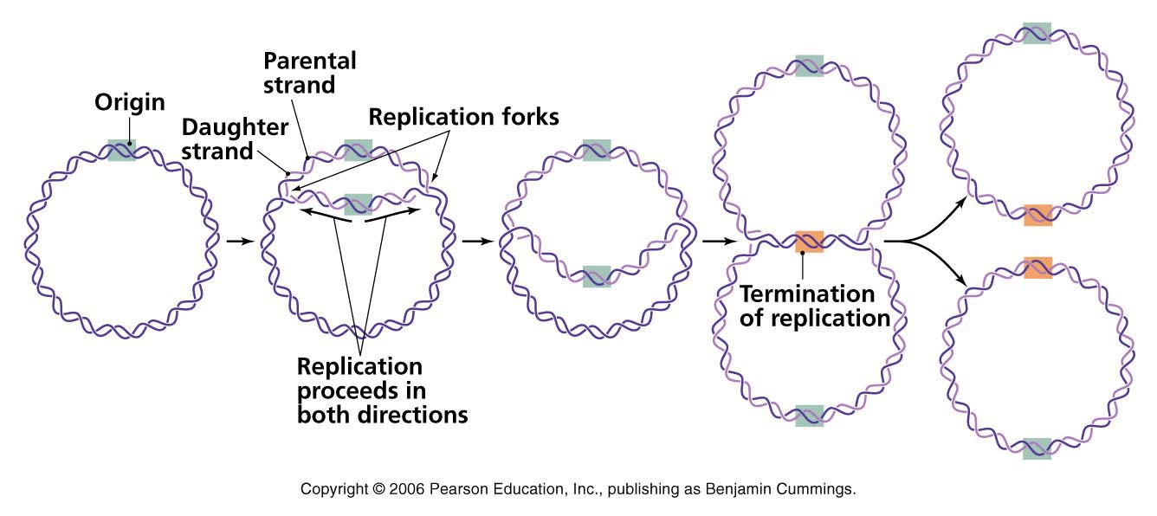
Some background information
Prokaryotes are haploid: for example, bacteria E. coli – it has only one chromosome
Bacterial chromosome is circular
Bacterial chromosome represent a single unit of replication
Bacterial cell can carry extra chromosomal replicating bodies, called plasmids
Bacterial chromosome
Plasmids

Slide 4
Transformation
Transformation
essentially means continuation of a piece of DNA or gene in a host for generations
What are the barriers to continuity of an incoming DNA in a cell?
What is the advantage of recombination here?
Incoming DNA must replicate to continue for generations
Answer:
Incoming DNA now replicates with the rest of the bacterial genome

Slide 5
Transformation by a plasmid (vector) DNA
Host bacterium
Host bacterium
Transformed by a plasmid
The transformed host bacterium and it progeny would express the gene (marker) carried by the plasmid: for instance, antibiotic resistance
What if the plasmid (vector) DNA is made into a recombinant DNA first before transformation?

Slide 6
Definitions of recombinant DNA (rDNA) and genetic engineering
Recombinant DNA: A new DNA molecule created by joining together two or more DNA fragments not normally associated with each other: for example a DNA from human and bacteria
Genetic engineering: The end product of genetic engineering is an organism that has been genetically modified using recombinant DNA technology without taking recourse to its natural course of mutation/ evolutionary changes etc

Slide 7


Recombinant DNA: definition
A unique piece of DNA artificially created by joining them together

Slide 8
Recombinant DNA: Vocabulary
Vector
Recombinant DNA
Restriction enzyme
Ligase
Transformation
Selection
Gene clone

Slide 9
Cloning Vectors
A cloning vector is a DNA molecule that has an origin of replication and is capable of replicating in a bacterial cell.
Most vectors are genetically engineered plasmids or phages.

Slide 10
Plasmids
What is a replicon?
Cloning vector
Plasmids: Extra-chromosomal genetic elements that are capable of autonomous replication (replicon)
What does these green area on the plasmids signify?
A marker (gene) that can be readily detected – antibiotic resistance, for example
What are the advantages of having a cloning vector
Transformation
Step 1
Step2

Slide 11
Characteristics of plasmid cloning vector :
Small size (<15Kb) for optimal efficiency of transformation in bacteria
Origin of replication-allows plasmid to replicate in the bacteria
Unique restriction enzyme sites for cloning
Carries selectable markers

Slide 12
Plasmid: it’s a circular DNA molecule containing:
a multiple cloning site or MCS
an antibiotic resistance gene
an origin of replication
MCS
ampR
Ori

Slide 13
Plasmids as a cloning vector
This is the DNA (green) that has been cloned in the plasmid vector
Origin of replication
Ampicillin resistance
A DNA vector
Self-replicating
Carries selection markers

Slide 14
Two most critical enzymes for recombinant DNA technology :
Cutting enzyme: Restriction endonuclease
Stitching enzymes : Ligase
Where do we find the cutting enzyme

Slide 15
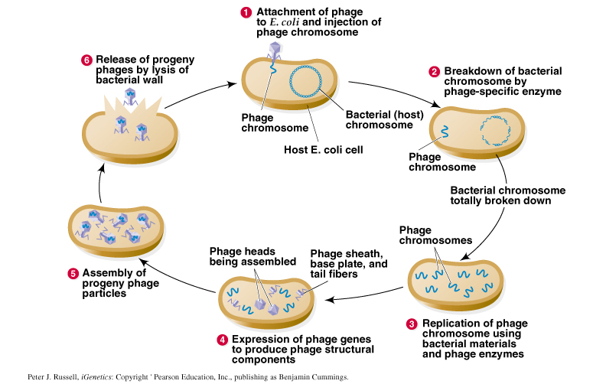
Lytic life cycle of a virulent phage, such as T2
The story of how restriction enzymes were discovered

Slide 16
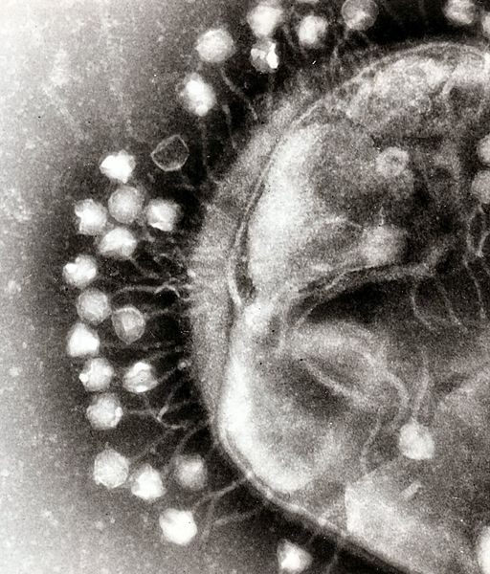
The story of how restriction enzymes were discovered
Restriction endonucleases are part of a bacterium’s defense against invaders
Restriction-modification systems allow the bacterium to distinguish self from non-self DNA
Restriction: bacterial endonucleases cleave both strands of foreign DNA at specific recognition sites
Modification: bacteria protect their own DNA by adding a methyl group to the recognition sites in their own DNA
Electron micrograph bacteriophage infecting a bacterium
Type II restriction enzymes are widely used in molecular biology:
enzymes cleave, but do not modify, their specific recognition sites

Slide 17

The story of how restriction enzymes were discovered
Discovery of Restriction endonucleases
Host 1
Host 1
Modification
Restriction
Host 1
Modification
Methylase
Discovery of restriction-modification system
Host 1

Slide 18
REs with 6-nucleotide recognition sites (6-cutters) are widely used in molecular biology
Sites would randomly be expected every 1/4096 nucleotides (1/4⁶)
Actual sizes vary widely with average of ~4000 bp
Recognition sites are often palindromes
Restriction Enzyme Strain of origin Recognition site
EcoRI E. coli (strain RY13) G A A T T C
Hind III H. influenza A A G C T T
BamHI B. amyloliquefaciens G G A T C C

Slide 19
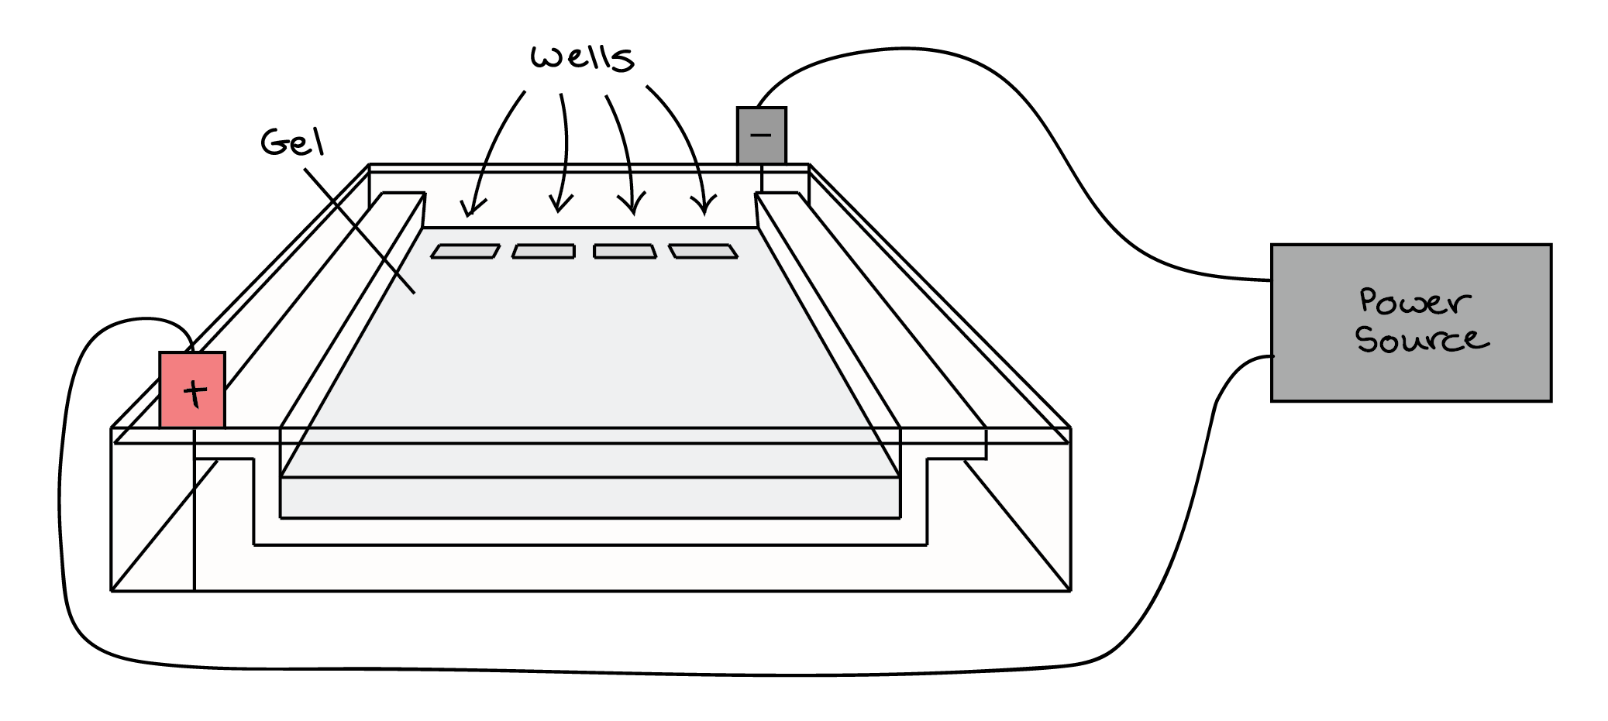

Slide 20
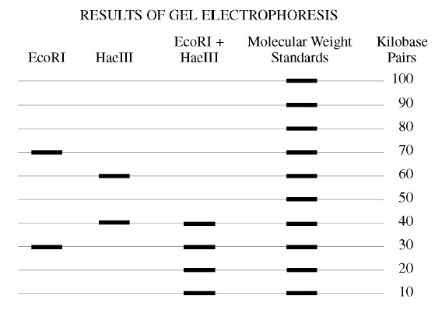
Utilities of Restriction enzyme: Precise, defined, and reproducible cuts that can be ligated again to create recombinant DNA
Results of gel electrophoresis: production of linear DNA fragments of different sizes by different restriction endonucleases
Plasmid DNA
10
9
8
7
6
5
4
3
2
1
At how many points did Eco RI restriction enzyme cut the circular plasmid DNA , if at after cutting one finds two leaner pieces of DNA : one 7 kilo bases and the other 3 kilo bases long? What is the length of the original circular plasmid DNA ?

Slide 21
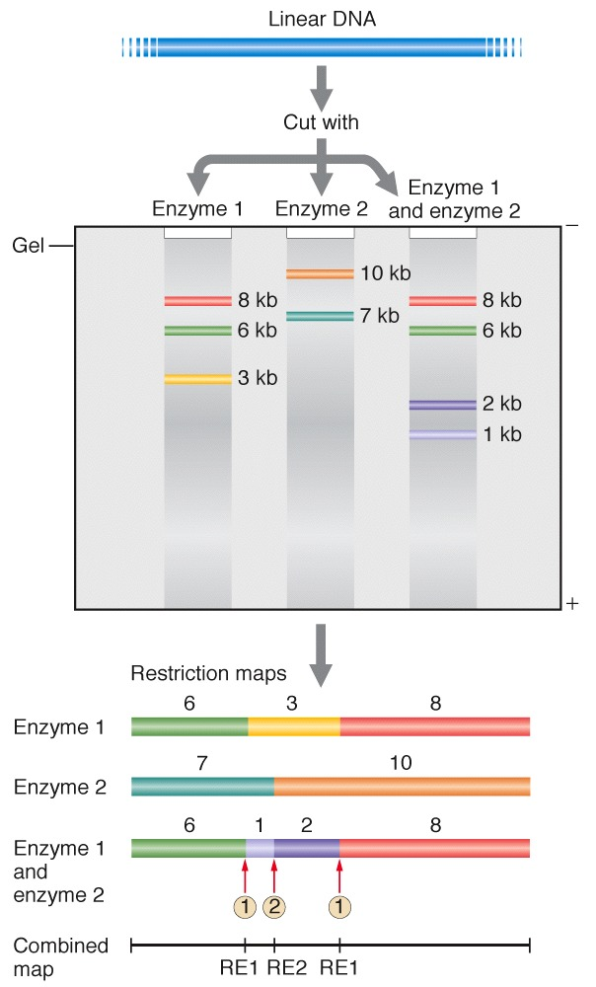
Restriction Maps
A restriction map is a linear (or circular) map of the order and distances of restriction endonuclease cut sites in a segment of DNA
Each DNA fragment, no matter what size, has its own unique restriction map
Restriction maps are useful in comparing DNA fragments to look for regions of identity

Slide 22
Restriction Mapping
Restriction endonucleases helps build maps of linear and circular molecules
HaeII
BamHI
EcoRI
HaeIII
A plasmic
Restriction map of a plasmid
A plasmid
HindIII
HaeII
What is the benefit of having a restriction map for a given piece of DNA?

Slide 23
Answer the following
What are RE cuts?
Why are the RE cuts unique??
What are the utilities of the RE cuts?
What can we now do with the RE cut DNAs?

Slide 24
What are the utilities of the RE cuts?
Example of EcoRI cut
Step 1
Is this a cut or a nick
G A A T T C
Will these two strand of DNA stay together or fall apart
C T T A A G
Step 2
G
A
A
T
T
C
These snap to create sticky end
+
C
T
T
A
A
G
Step 3
Ligated
Ligated
G A A T T C
C T T A A G

Slide 25
What can we now do with the RE cut DNAs?

Slide 26
The first cloning experiment done by Boyer and Cohen

Slide 27
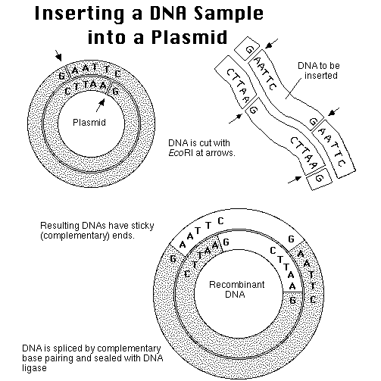
You can call this as a passenger/foreign DNA that is being carried to the bacterial host cells by the plasmid vector (carrier)

Slide 28
Basic Cloning Process
Plasmid is cut open with a restriction enzyme that leaves an overhang: a sticky end
Foreign DNA is cut with the same enzyme.
The two DNAs are mixed. The sticky ends anneal together, and DNA ligase joins them into one recombinant molecule.
The recombinant plasmids are transformed into E. coli
Cells carrying the plasmid are selected by adding an antibiotic: the plasmid carries a gene for antibiotic resistance.

Slide 29
RECAP
Plasmid and DNA cloning
Origin of replication
This is the DNA (green) that has been cloned in the plasmid vector
Ampicillin resistance
A DNA vector
Self replicating
Carries selection markers
It can be made into a recombinant DNA and thus used to clone genes
Transformed bacterial clone would then represent a gene clone as well.
Can you now tell the meaning of a gene clone?

Slide 30
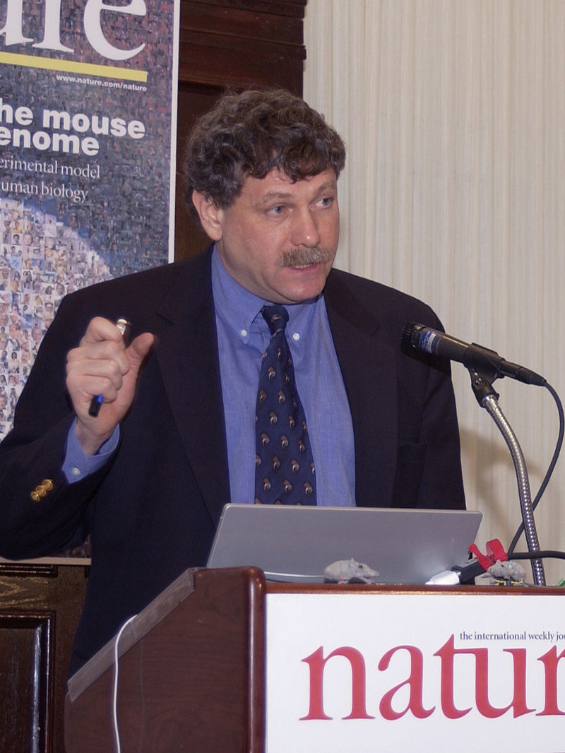
All the videos displayed here are useful for appreciating genetic engineering/gene cloning / recombinant DNA technology
YouTube video for gene cloning cartoons
https://www.youtube.com/watch?v=sjwNtQYLKeU
Khan academy YouTube link for gene cloning
https://www.youtube.com/watch?v=5ffl-0OYVQU
MIT open courseware : Speaker - Eric Langer
Course: fundamental of biology
Topic : Basic mechanisms of cloning I and II
https://www.youtube.com/watch?v=CdAgzk5tQhs
https://www.youtube.com/watch?v=reYwbnuhFU0
Dr. Eric Lander, Director of the Broad Institute of MIT and Harvard, speaks at the Mouse Genome Sequencing Press Conference on December 4, 2002

Slide 31
If you have understood the topic covered then you would
Question:
If you are provided with plasmid DNA and also human DNA, will you be able to create a recombinant DNA?
Can this DNA be cloned?

Slide 32
Where has molecular cloning (genetic engineering) led us to
How to interpret the human genome | Alisha Holloway | TEDxClaremontColleges
https://www.youtube.com/watch?v=Mph3GfDKM-o
Watching such videos will help you connect with the impact of the genetic engineering has made in understanding human health and diseases

